Slide 1
Creating a Strong Biotech Pitch Deck

Slide 2



Why do you need a strong biotech pitch deck?
Receive buy-in and funding from investors
Build credibility and trust in the industry
Build your communication skills

Slide 3
Table of contents
What is a pitch deck, and why is it important? (Slides 3-5)
Where investor slide decks fail (Slides 6-11)
Free investor slide deck template (Slides 12- )

Slide 4
What is a pitch deck?
An introduction

Slide 5
What is a pitch deck?
A pack of slides that introduces your company to the business world
Material that you need to describe your ideas and goals to potential investors
Your chance to get investors excited about what you’re doing to make the world a better place

Slide 6



Outcomes of a strong pitch deck
Secured US$17M in Series B funding
A Toronto-based biotech company
Acquired by Recursion
Secured $56M in Series B funding
AI-powered therapeutic solutions for patients with rare diseases
Secured $11M in Series A funding via venture capital and angel investor funding
Online platform for patient recruitment, engagement, and genetic testing
See more pitch decks at https://bestpitchdeck.com/

Slide 7
What this slide deck is about
Components of a pitch deck
Mistakes you must avoid in your pitch deck
How can you make a good pitch deck?

Slide 8

Before you proceed!
Avoid these mistakes!

Slide 9
Points of failure in investor pitches
What is your business proposition?
Too much jargon
A poorly designed presentation
Not practising your presentation

Slide 10

Failing to communicate your business concept
VCs review hundreds of decks each week alongside their many commitments
More important than keeping your slide deck short, your slide deck must grab attention immediately with its solution and financial potential
What you must do: Clearly articulate the problem, your solution, and your solution’s novelty throughout your deck

Slide 11

Too much jargon!
Jargon: specialized terms that require more explanation to non-experts
Too much jargon and audiences may struggle to picture how your technology does what it’s supposed to do
What you must do: relate your technology in business terms and explain jargon
NOTE: Jargon itself is not a bad thing if you believe your investors can understand it and if you can explain it without rushing

Slide 12
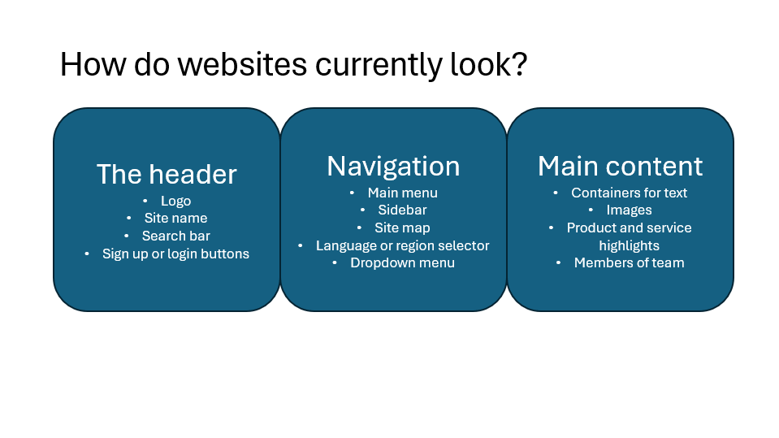
A poorly designed presentation
Most slides contain too much text and too few images, like this one
This slide says nothing about why websites now don’t look good
The text is too small
What you must do: ensure that investors can understand each slide with a quick glance
Make sure your slides are easy to read

Slide 13

Not practicing your presentation
An unclear message is one of the biggest points of failure for any startup, and you have a limited time to present.
Entering a pitch unprepared will not help you articulate your thoughts clearly
What you must do: determine ahead of time your key message and practice your presentation thoroughly

Slide 14
The template
The components of a strong pitch deck

Slide 15

The problem
If you want to explain your problem, consider:
What are people across the life sciences or biomedicine struggling with?
How will not solving this problem affect their bottom line or their ability to provide timely, effective care?

Slide 16

Your solution
How will your solution address the problem directly?
Take this opportunity to hook your investors in. Relate your solution to improved efficiencies in workflows, costs, and health outcomes
Be sure to back up your claims with empirical data

Slide 17

How it works
You’ve been waiting a while to talk about the science, but now is your chance
Use jargon if you know your audience understands it
E.g. Pharmacokinetics, toxicity, translation to humans from animal models, etc. for therapeutic candidates
Always link your research back to the solution and market outcomes

Slide 18

The market landscape
Goal: show that your technology, therapeutic, or product can penetrate its target audience
Investors speak the language of money. You will need computed numbers to support your claims of market size and potential
Note: A small market is not necessarily an issue unless there’s substantial competition
E.g. Multiple candidates targeting the same pathway for a disease

Slide 19
An example graphic — market landscape
TAM: Total Addressable Market
You want this section to cover the total potential to get investors imagining the possibilities
E.g. How many total paying patients for a specific type of cancer indication?
SAM: Serviceable Available Market
You want to service as much of the market as you can while remaining realistic
E.g. Are there cancer patients who won’t be eligible for your therapeutic?
SOM: Serviceable Obtainable Market
How much of the market can you capture in a specific time frame?
TAM
SAM
SOM

Slide 20

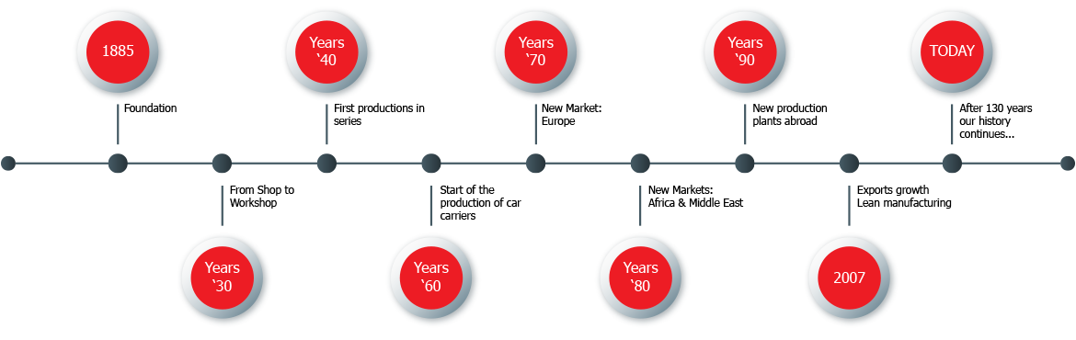
Other things you can include — market landscape
A timeline
A comparative bar graph
Using as many visuals as you can will help investors capture your current financial and market status
Timelines will help you create a road map to outline your company’s financial trajectory
Bar graphs will help you establish your market presence

Slide 21



The team
COO and Co-Founder
CEO and Founder
CTO and Co-Founder
Highlight your team’s experiences and achievements
If you’re planning to expand your team, mention who else you’re looming for and when you will recruit them

Slide 22

The advisors
Obtain a startup advisor when you:
Need to build connections
Improve your fundraising results
Require regulatory expertise
Advisors can help build trust and prestige with investors, on top of expertise

Slide 23
Business model
This section provides the inner workings of how your business will operate
Investors will search for several key signs that you can build a viable product and achieve your market objectives
The signs:
Is your idea original, and is it better than what the rest of the market has?
Is the market you’re working in viable and realistic enough for investors to get their returns?
Is your burn rate reasonable? => are you keeping your costs under control?

Slide 24
Road map
Investors want to know how you will reach the goals you’ve proposed to them
Include milestones and deadlines
Make sure your milestones are realistic
Prediscovery
Due diligence and validation
Initiate clinical trials

Slide 25
Financing requests
The slide where you tell your investors the following:
Money raised to date
Money seeking to raise for the rest of your round
Your plans for the finances
How long your new funds will last

Slide 26
One final checklist
Do you have a consistent Powerpoint design that’s clean, yet visually engaging?
Did you clearly articulate your vision and proposition?
Did you describe the key problem in the industry that your problem can solve?
Did you make sure that your market size and financial numbers are correct?
Did you make sure there are no typos on your slides?

